Slide 1
Microbiology Dep.
Second year
Parasitology
9th Lec.
Lecturer: Assist prof.
Dr. Sally Ahmed
3- Hymenolepis nana
Common name: Dwarf tape worm
Synonyms: Vampirolepis nana
Disease: Hymenolepiasis nana, Dwarf tape worm infection. Hymenolepiasis nana is an infection by adult and larval stage of H. nana. It is found warld wide, primarily limited to children in warm climate.
Morphology: Small 25 to 4o mm in length, 1 mm in breadth
• Scolex: Small, globular with short rectactile rostellum, 4 sucker s and a single ring of 2o to 3o minute hooklets.
• Strobila: 2oo segments, broader than long
• Mature proglottids: single genital pore on one side of segment
• There are 3 round testes lie in the posterior part of each segment, Bilobed ovary lie posteriorly between the testes with compact vitelline gland behind.

Slide 2
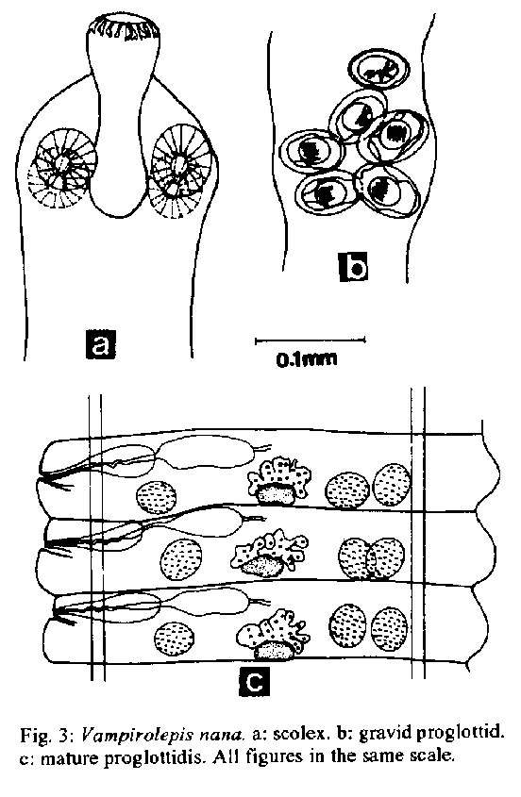
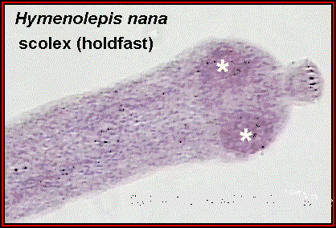
• Gravid is uterus forms a sac filled with eggs. Gravid segment destroyed in the intestine releasing the eggs which are found in faeces.
• Egg: nearly spherical 3o _ 47 μ m in diameter. with two thin membranous shell s . The inner one with 2 polar thickenings, each provided with 4 to 8 long thread like filaments extending into the space between the inner and outer shells. The centrally located hexacanth embryo is equipped with 3 pairs of hooklets
Hymenolepis nana

Slide 3
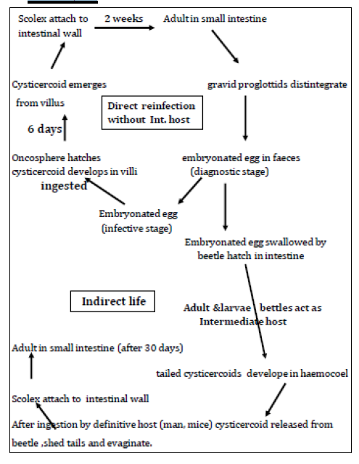
Life Cycle

Slide 4
Pathogenesis and symptomatology:
Infection with H. nana produces No symptoms in light infection or may be diarrhea, anorexia, vomiting, loss of weight, pruritus of the nose and anus, urticaria. Heavy infection causes diarrhea, abdominal pain,
anorexia and nervous disorders.
Diagnosis:
By demonstration of the egg in the stool.
Epidemiology:
Infection iscommonly acquired by anus to mouth transmission of eggs. (Hand, food) is more common in children.
Occasional infection may occur from rodent source.
Control:
a) Good personal hygiene and sanitation
b) Treatment of infected person.

Slide 5
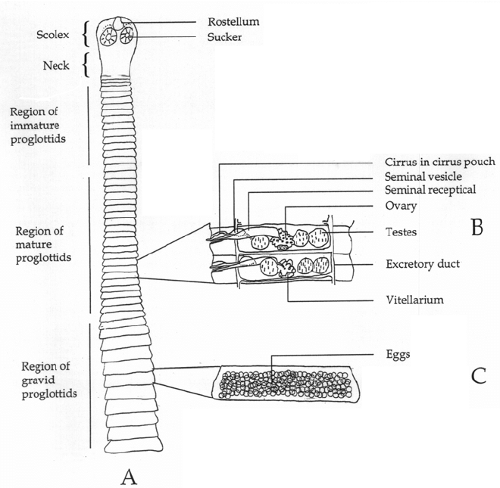
4- Hymenolepis dimenuta
Common name: Rat tape worm infection
Habitat: in the small intestine of Rat and mice and rarely in Human.
Morphology:
• 2o-6O Cm in length by 3.5 to 4.o mm in width, with 1.000 proglottids
• Scolex: o.4 mm wide with 4 suckers and retractable and un armed rostellum.
• Proglottids as in H.Nana.
• Egg: Ovoid to sub spherical 72 to 86 μm by 6o to 79 μm with a space between the outer tanned egg membrane and the hyaline inner membrane which provided with a pair of pollar thickenings but lack the
polar filaments.

Slide 6
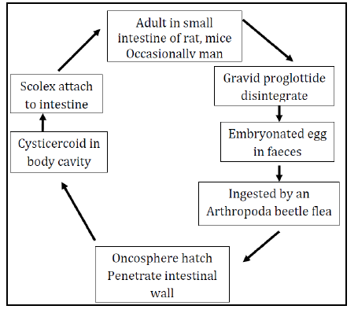
Life cycle

Slide 7
Pathogenesis: Nonpathogenic but may produce mild diarrhea and
abdominal pain.
Diagnosis: By demonstration of eggs in stool.
Epidemiology: H. diminuta is worldwide in distribution. Human infection is associated with the contamination of cereals, grains by infected grain beetles. Infected fleas may transferred to the mouth by dirty hands.
Control:
1) Eradication of rat around the home.
2) Protection of food such as grain and cereals from rat dropping and from insect.

Slide 8
5. Echinococcus granulosus (hydatid disease/hydatidosis)
The genus Echinococcus contains four species (E. granulosus, E. multilocularis, E. vogeli and E. oligarthrus) for which humans are hosts to the larval stage, or hydatid. The final host of Echinococcus is always a carnivore and the degree of host specificity expressed is far greater than at the intermediate host level. Although hydatid disease, hydatidosis and echinococcosis are all terms used to refer to infection with the metacestode (hydatid cyst), the terms hydatid disease and hydatidosis should be restricted to infection with the metacestode, and echinococcosis to infection with the adult stage. In Iraq, hydatidosis is the most common helminthic zoonosis, which affects humans and a wide range of livestock species, with a major medical, social and economical burden. The clinical and economic significance of the parasite are almost completely confined to infection with the metacestode. Echinococcus granulosus has been isolated from stray dogs from most parts of Iraq.

Slide 9
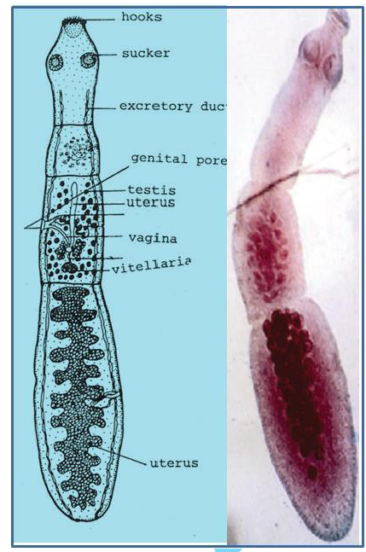
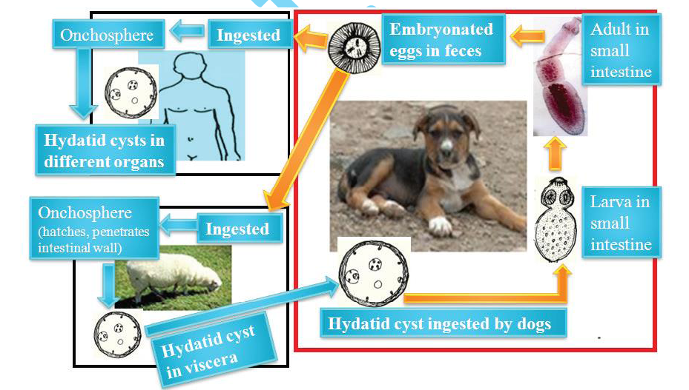
Life cycle

